Slide 1
SENTIMENT ANALYSIS OF TWEETS
Predicting a Movie's Box Office Success
Vasu Jain
Shu Cai
12/05/2012

Slide 2
SENTIMENT ANALYSIS OF TWEETS
Predicting a Movie's Box Office success
Under Guidance of : Dr. Yan Liu

Slide 3
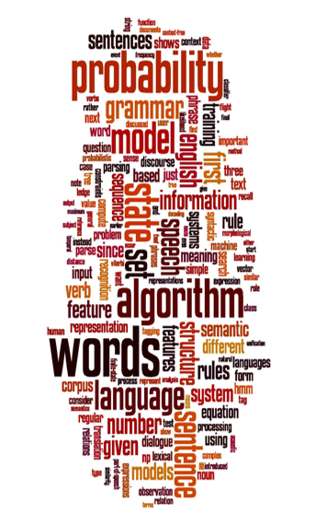
AGENDA
1. Introduction
2. Related Work
3. Methodology
4. Experiments
5. Conclusion
6. Q and A
Image source: SNLP Slides for Sentiment Analysis

Slide 4

INTRODUCTION
About Twitter
Social networking and microblogging service
Enables users to send and read messages
Messages of length up to 140 characters, known as "tweets".
Tweets contain rich information about people’s preferences.
People share their thoughts about movies using Twitter.
Data analysis on twitter data to predict the success of a movie.

Slide 5

INTRODUCTION
People’s opinions towards a movie have huge impact on its success.
Our project includes prediction using Twitter data, and analysis of the prediction results.
High volume of positive tweets may indicate success of a movie. But how to quantify ?
Image source: http://www.demainlaveille.fr/2012/05/06/pourquoi-twitter-ne-peut-pas-predire-les-elections-presidentielles/

Slide 6
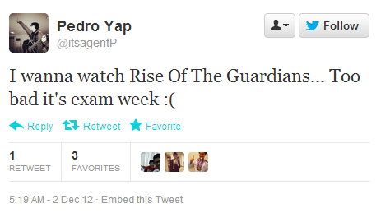
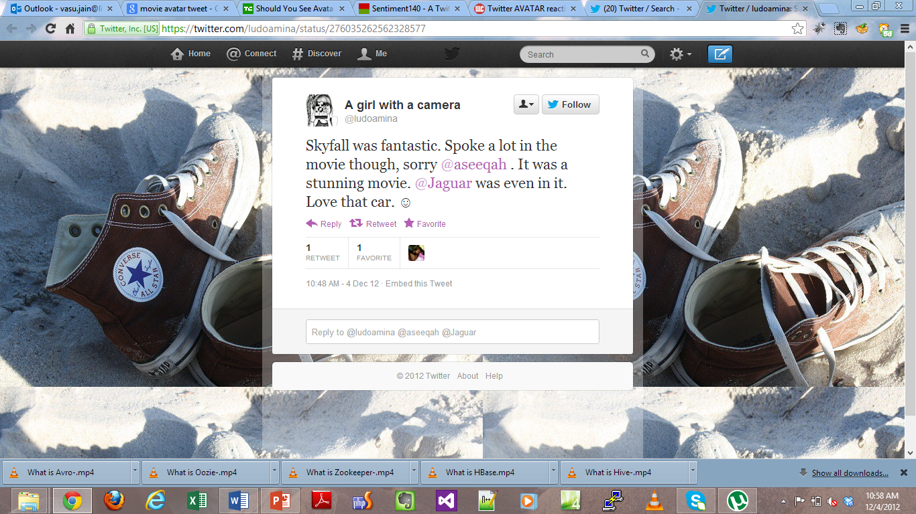
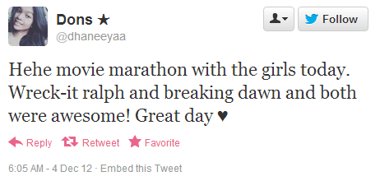
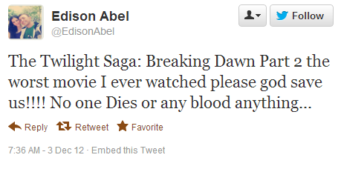
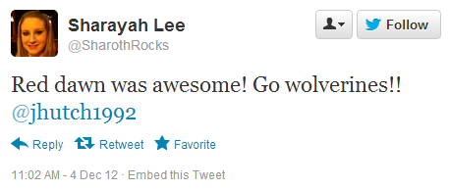
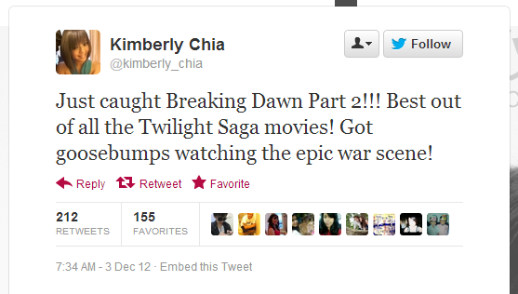
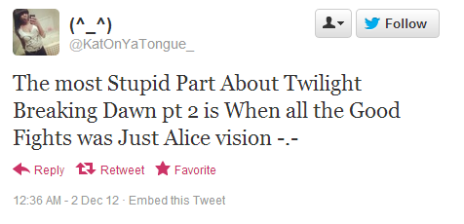

Slide 7

RELATED WORK
Using social media to predict the future becomes very popular in recent years.
Predicting the Future with Social Media (Sitaram Asur & Bernardo A. Huberman, 2010) tries to show that twitter-based prediction of box office revenue performs better than market-based prediction.
Predicting IMDB movie ratings using social media (Andrei Oghina, Mathias Breuss, Manos Tsagkias & Maarten de Rijke 2012) uses twitter and youtube data to predict the imdb scores.
Our project includes prediction using Twitter data and investigation on two new topics based on the prediction results.

Slide 8
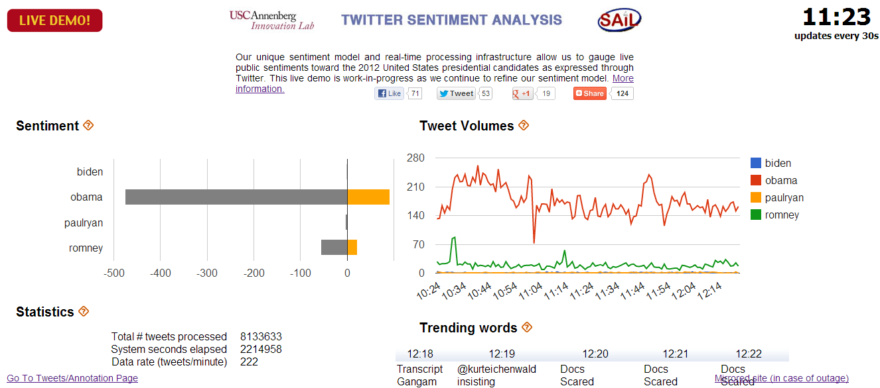
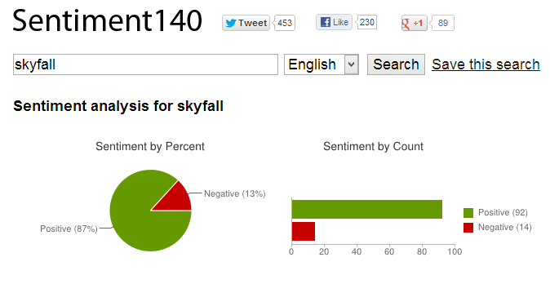
RELATED WORK
Predicting the results of presidential election (USC Annenberg Innovation Lab & USC SAIL).
Sentiment 140 to discover the Twitter sentiment (sentiment140.com) . No movie prediction is provided.

Slide 9
OUR WORK
Data Collection: existing twitter data set and recent tweets via Twitter API
Data Pre-processing: get the "clean" data and transform it to the format we need
Sentiment Analysis: train a classifier to classify the tweets as: positive, negative, neutral and irrelevant
Prediction: use the statistics of the tweets' labels to predict the movie success (hit/flop/average)

Slide 10

METHODOLOGIES: Data Collection & Crawling
2009 Data set Subset of Stanford dataset (now unavailable)
477 Million Tweets, period of June – Dec 2009
Filtered tweets during critical period for movie
68.7 GB datasets (compressed format)
30 movies, 6 Million relevant Tweets
2012 Data set live crawling using a script
Streaming API of python library for Twitter
to collect data
Data Retrieval using keywords for movies
Data collection focus on critical period
8 Movies, 2.5 Million Tweets
Image source: http://drupal.org/project/twitterminer

Slide 11
METHODOLOGIES: Data Collection & Crawling
Critical Period for movie “Harry Potter and the Half-Blood Prince".
Show the relationship between sent time and number of tweets for the movie
Image source: http://drupal.org/project/twitterminer

Slide 12

METHODOLOGIES: Data Preprocessing
Why data preprocessing ?
Lot of noisy, spam, irrelevant tweets in our dataset
Convert the data to input format for our sentiment analysis tools.
Techniques for preprocessing:
Removing URLs, user handles
Language detection to discard tweets not in English
Split the dataset into small chunks ~25000 Tweets/Chunk
Process chunks distributely
Filter for tweets related to target movies using regular expression.
Image source: http://mashable.com/2012/03/18/tweets-more-trustworthy-study/

Slide 13
METHODOLOGIES: Sentiment Analysis
Algorithm:
Labelling tweets using Lingpipe sentiment analyzer, a natural language processing toolkit.
Sentence (tweet) based analysis with a logistic regression classifier. (Accuracy up to 80%)
Training & evaluation using 2009 dataset, testing on 2012 dataset.
Trained classifier labels tweet as positive, negative, neutral or irrelevant.
Calculate PT-NT Ratio for every movie. PT-NT Ratio is a function over parameters positive tweet ratio, negative tweet ratio, total tweets, neutral tweets, irrelevant tweets.
Thresholds to determine regions for PT-NT Ratio. Each region corresponds to Hit, Flop, Average results for movies.
Movie success correlated with PT-NT Ratio.

Slide 14
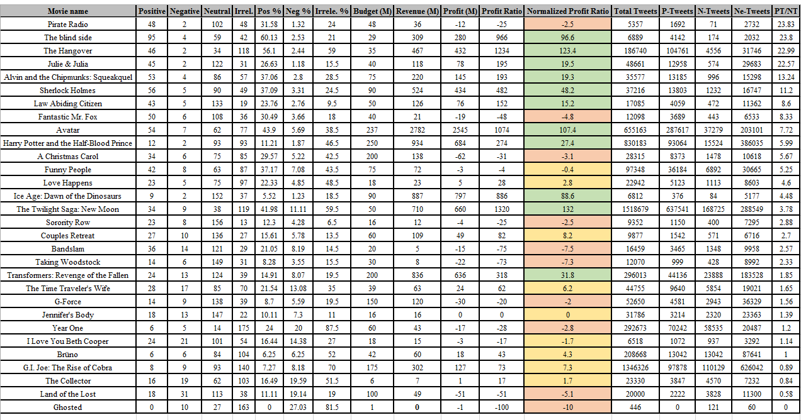
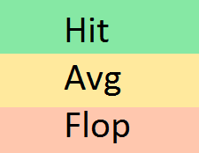
Experiments: Analysis of 30 Movies (Released in 2009)

Slide 15
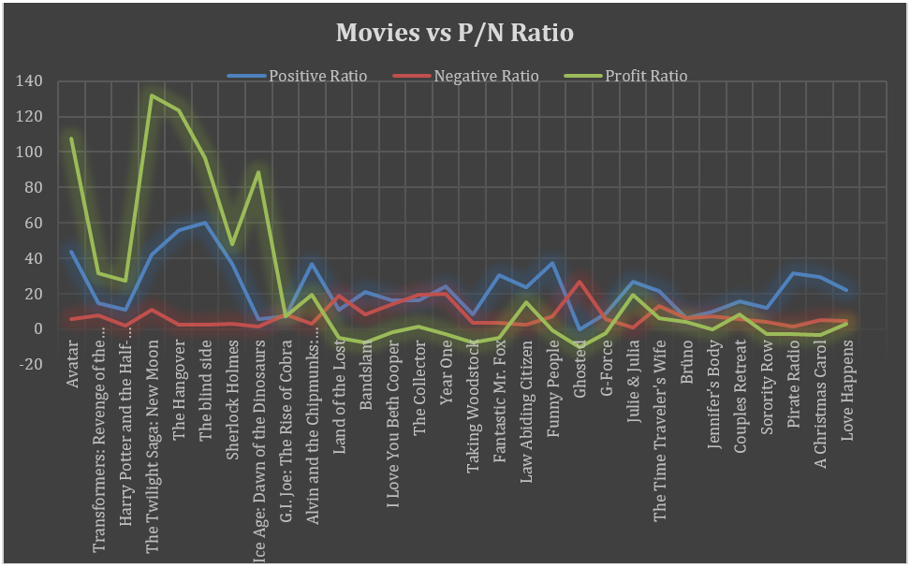
Experiments: Movies vs. P/N Ratio, Profit Ratio

Slide 16
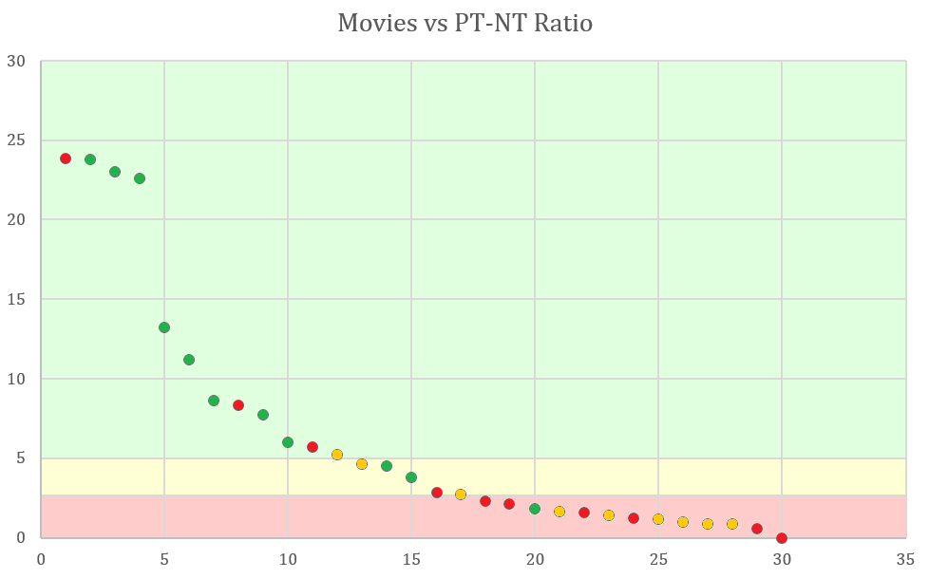
Experiments: Movies (Released in 2009) vs. PT-NT Ratio

Slide 17
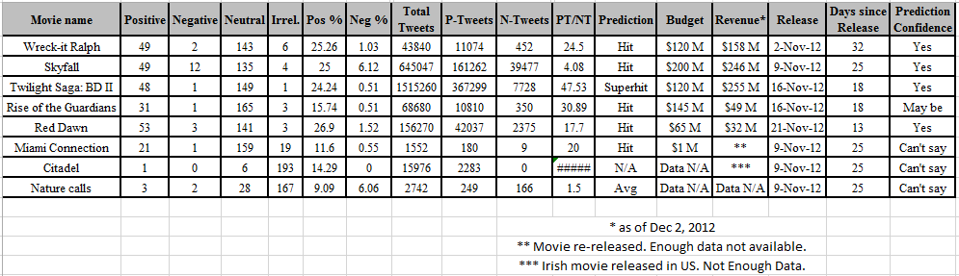
Experiments: Analysis of 8 Movies (Released in 2012)

Slide 18
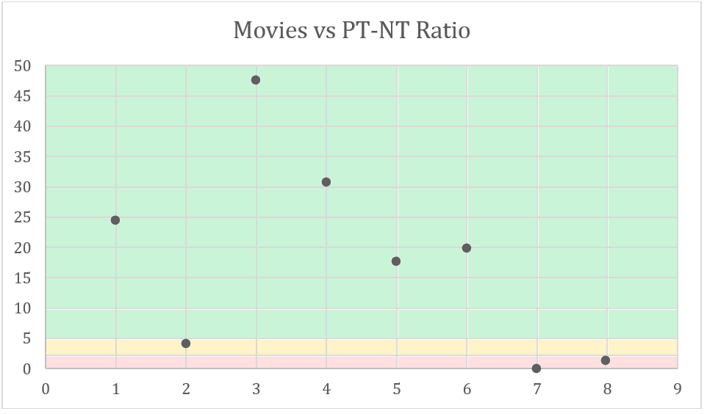
Experiments: Movies (Released in 2012) vs. PT-NT Ratio

Slide 19
Conclusion
Prediction for 2012 movies using our analysis:
5 movies: Hit
1 movie: Super hit
1 movie: Average business
Could not determine success rate for one due to it data unavailability.
Comparing our prediction results with box office results till date
Prediction: exactly right for four cases
On border line between hit and average for one case
For remaining movies we lack data to check our prediction onfidence .
Half accuracy score if movie’ s classification near border.
Score of 4.5 out of 5 for accuracy that is equal to 90%.
Great achievement for our model even though there were limitations with number of movies, hand labeled tweets etc.

Slide 20

Future Work
Bottlenecks:
1. Twitter data crawled by third party.
2. Limitation with Twitter APIs for crawling data.
3. Noise included in randomly picked 200 tweets.
Movies being released in limited number of theaters (Not enough data)
With more data, model can be more accurate and reliable.
Future work:
Using different other models and algorithms.
Temporal analysis can be added as a future work in the project.
Consideration of Retweets as a factor
Image source: http://www.theispot.com/whatsnew/2012/2/brucie-rosch-twitter-data.htm

Slide 21
Thank you
Q/A

Slide 22
Extra Slides

Slide 23
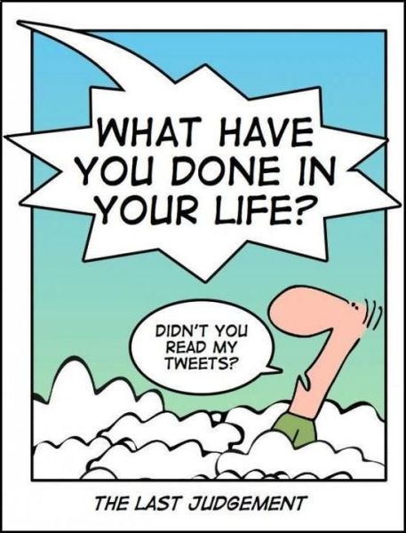
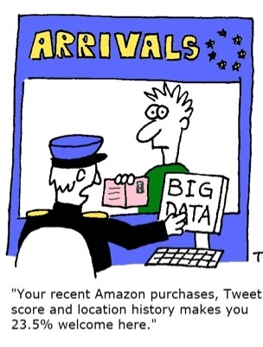

Slide 24
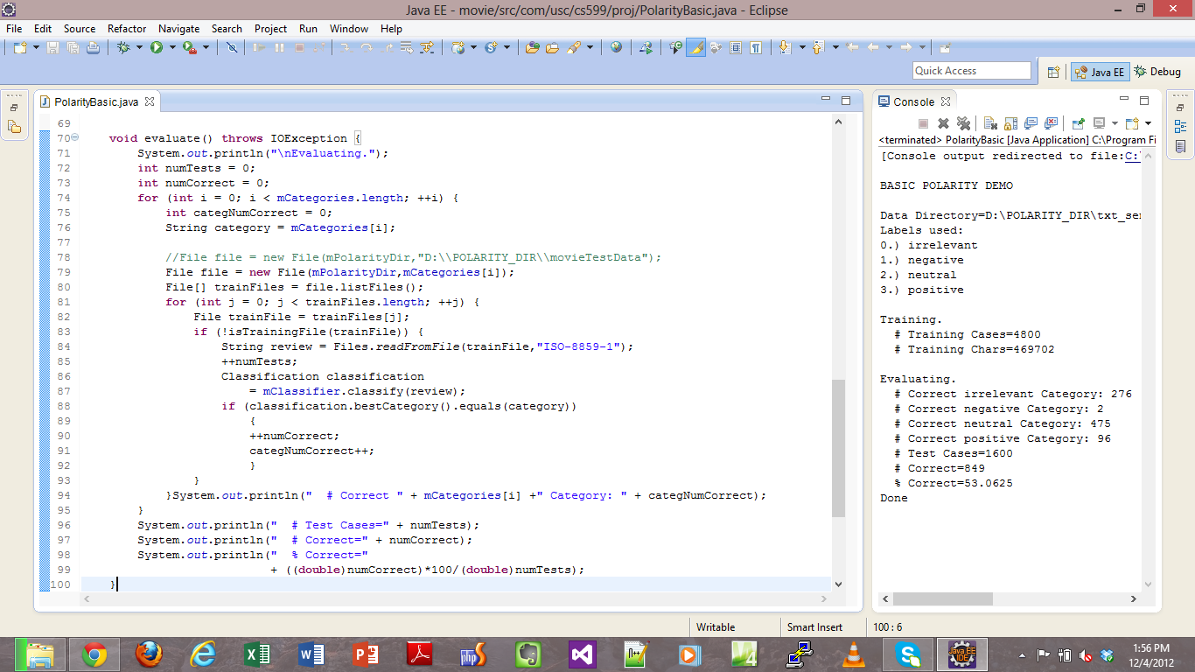
Experiments: Snapshot of Ling pipe's labelling results

